Slide 1
WELCOME
TO
THE PROJECT PRESENTATION

Slide 2
Presentation Topic: Website(BLC) Testing

Slide 3
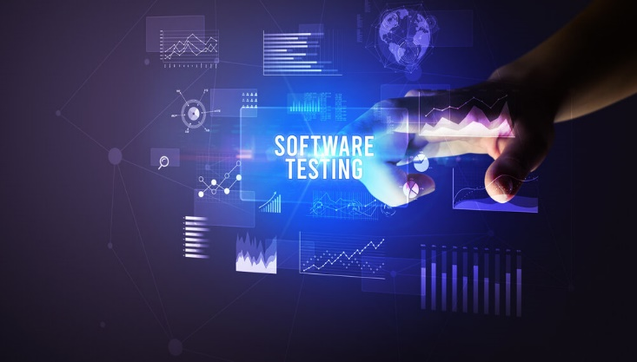
CONTENT
INTRODUCTION
PURPOSE OF TESTING
LOAD TESTING
STRESS TESTING
CONCLUSION

Slide 4
INTRODUCTION
Software Testing is the process of executing a program or system with the intent of finding errors. Software is different from physical systems in that it can fail in many bizarre ways. Testing is an integral part of software development, with more than 50% of the development time spent in testing. The Complexity Barrier principle states that software complexity grows to the limits of our ability to manage it, and society is unwilling to limit it.

Slide 5
PURPOSE OF TESTING
The purpose of testing software are given below:
Identifying defects
Detecting errors, or issues in software applications
Ensuring the specified requirements
Function correctly
Providing a satisfactory user experience
Good Quality Assurance
Overall, software testing plays a crucial role in ensuring the reliability, functionality, and quality of software applications and Promotes Organization, Productivity, and Efficiency.

Slide 6
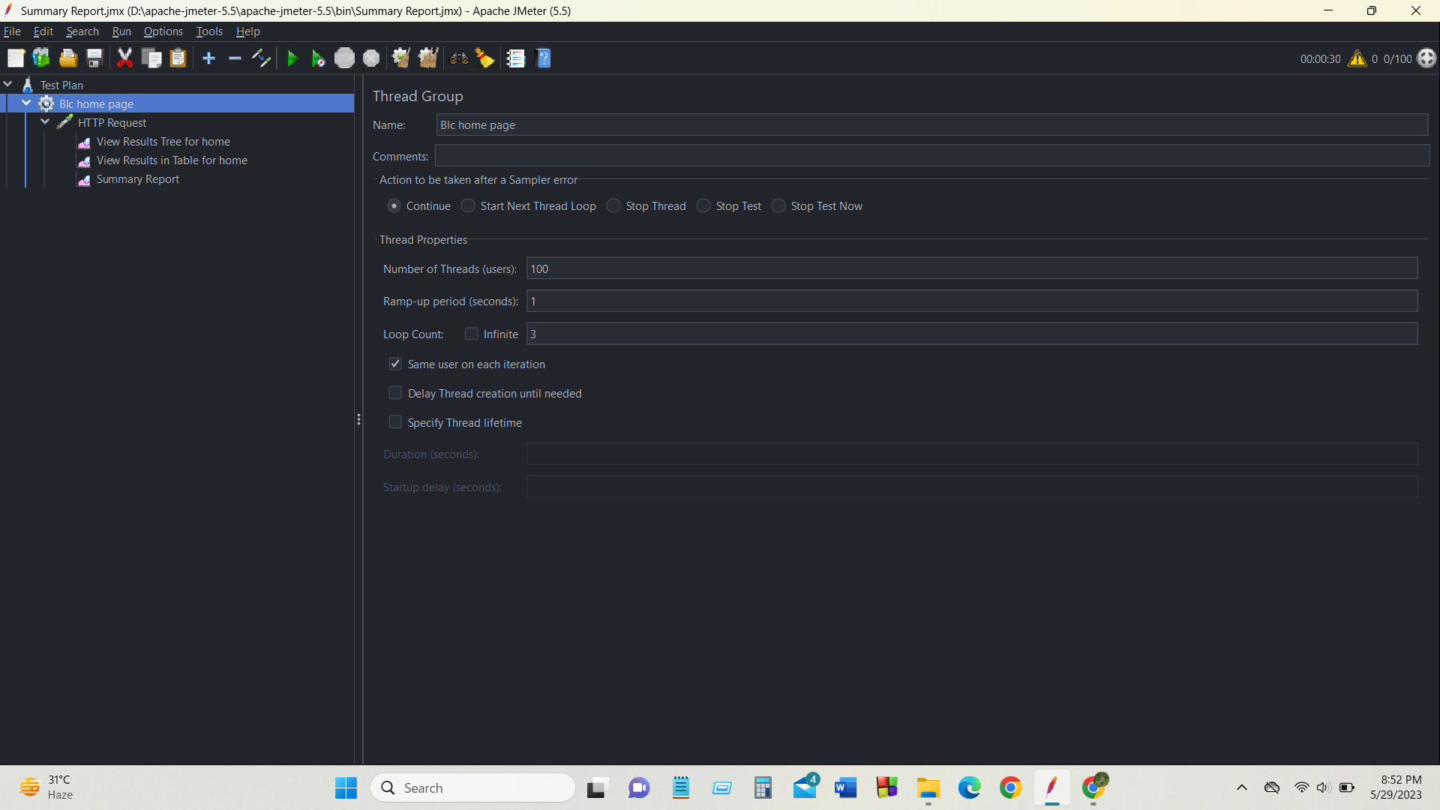
LOAD TESTING

Slide 7
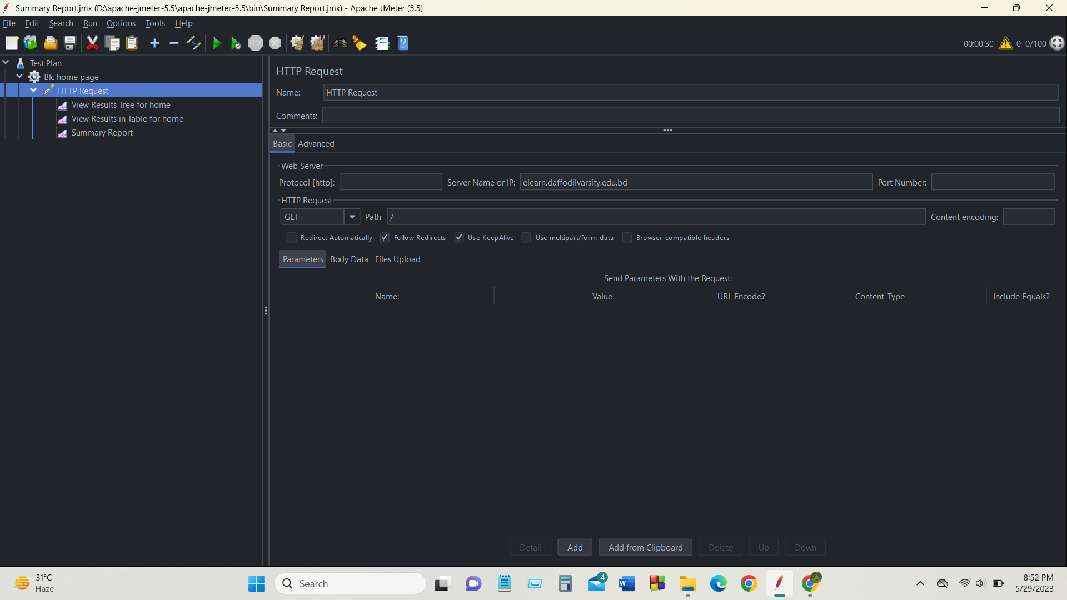
LOAD TESTING

Slide 8
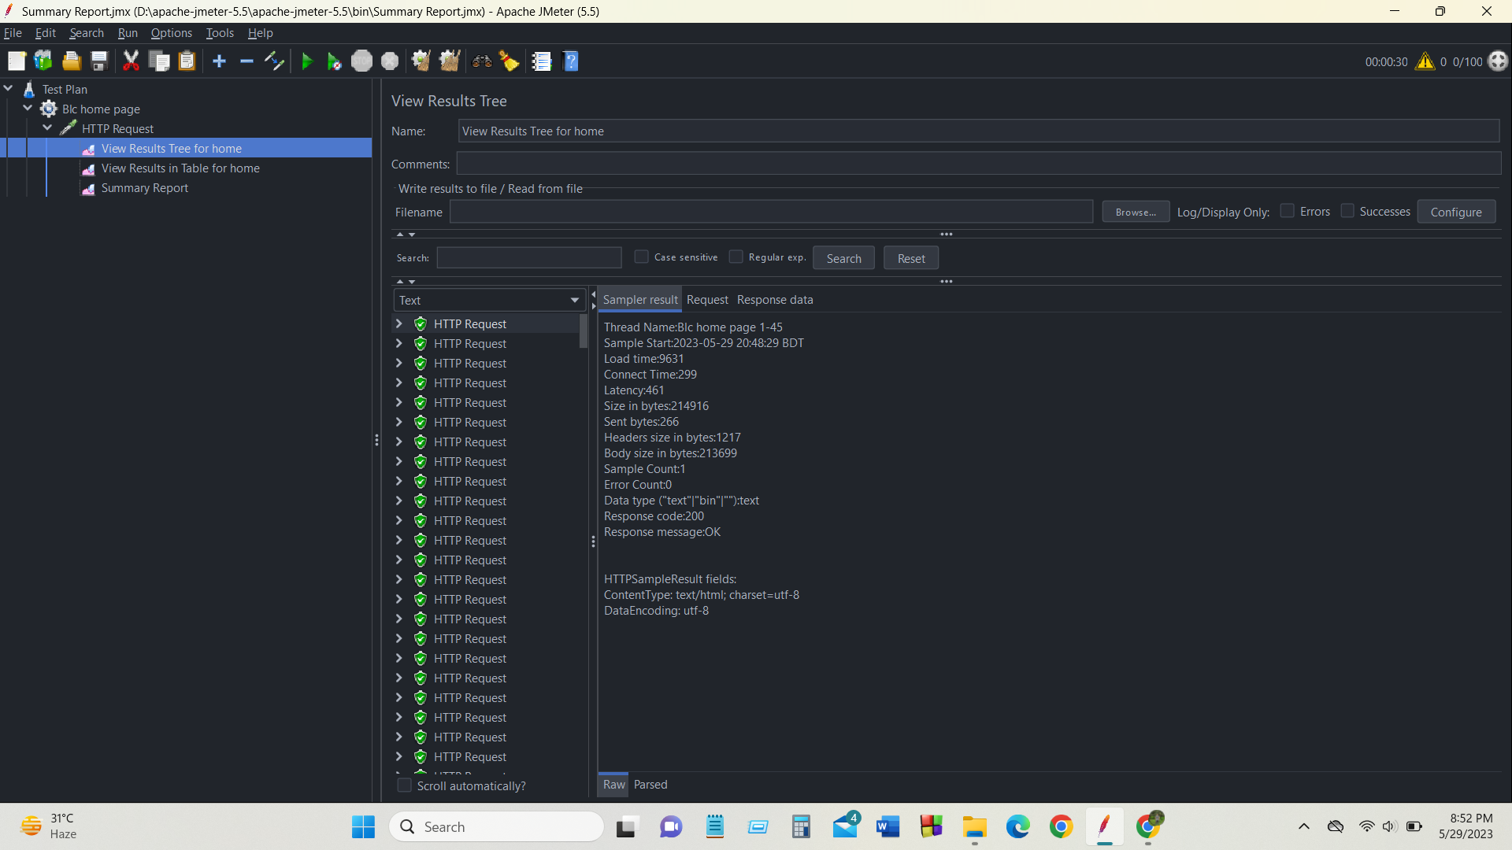
LOAD TESTING

Slide 9
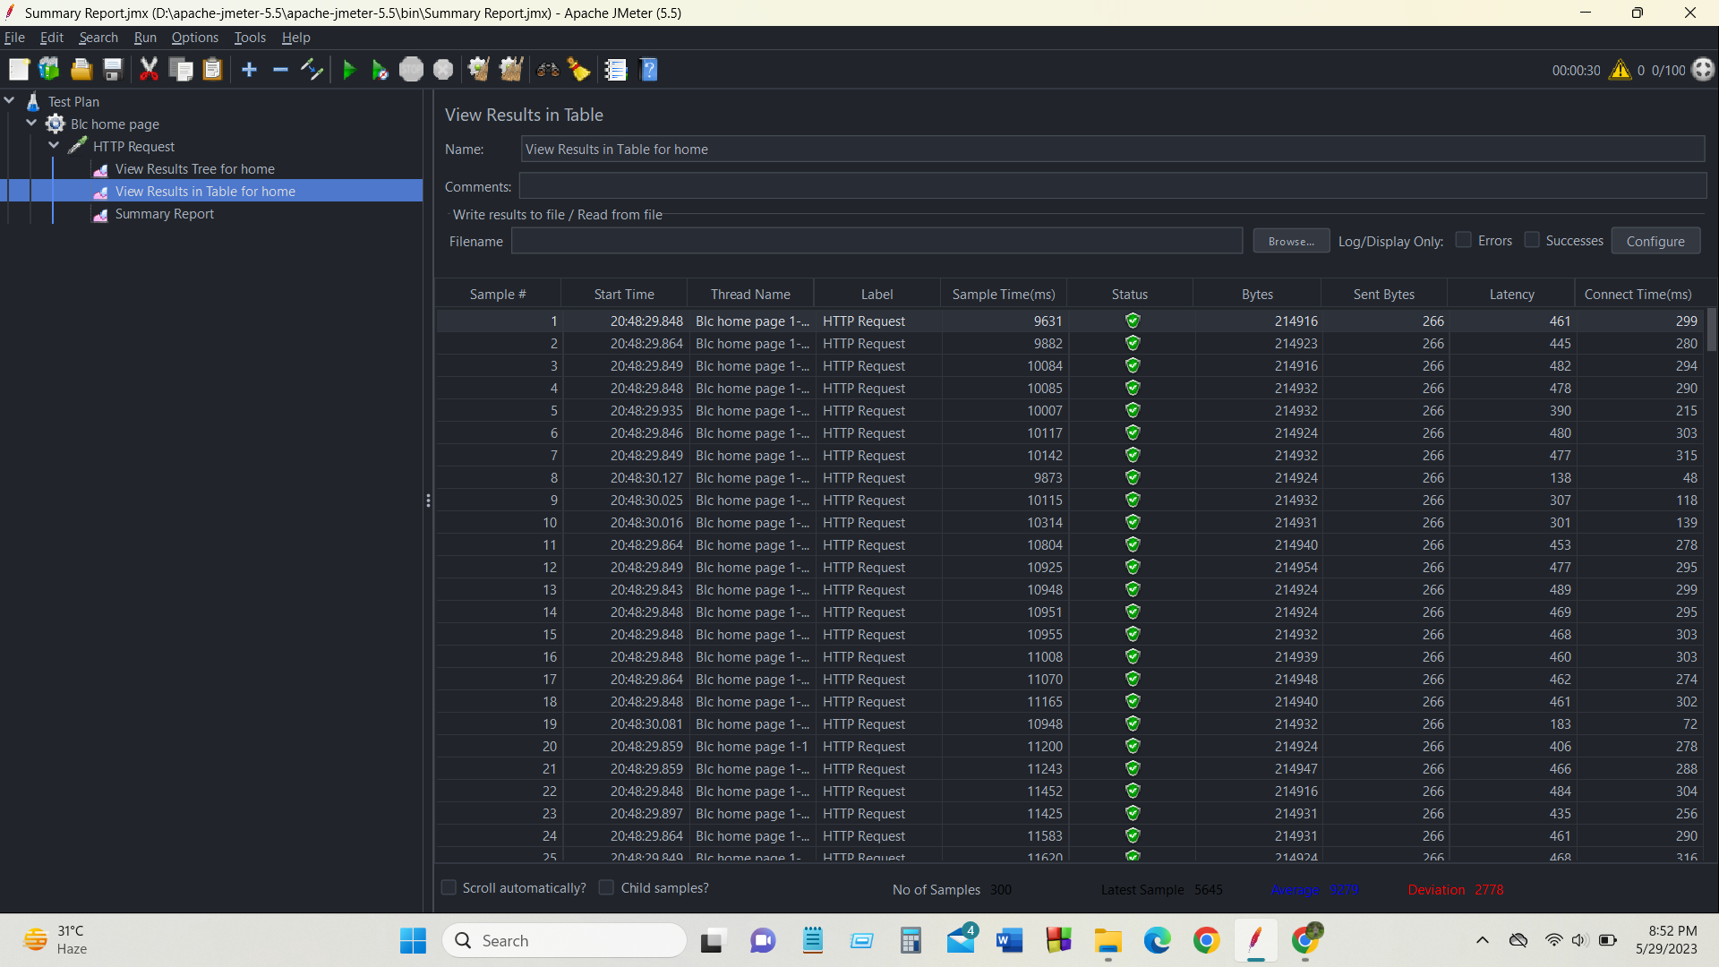
LOAD TESTING

Slide 10
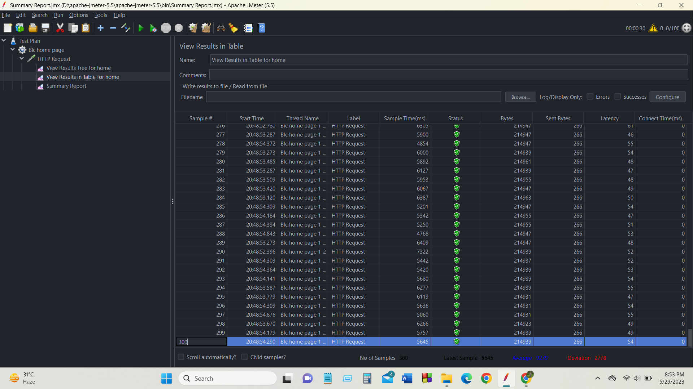
LOAD TESTING

Slide 11
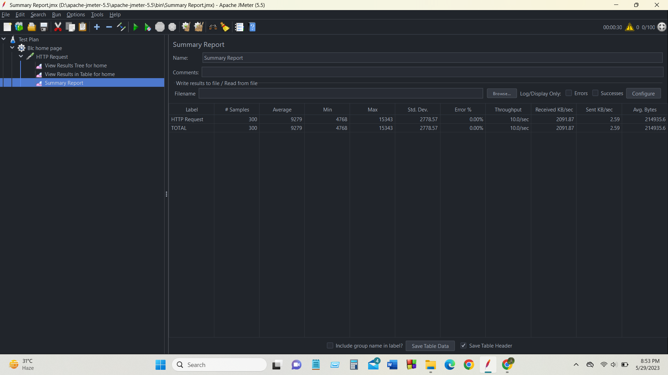
LOAD TESTING

Slide 12
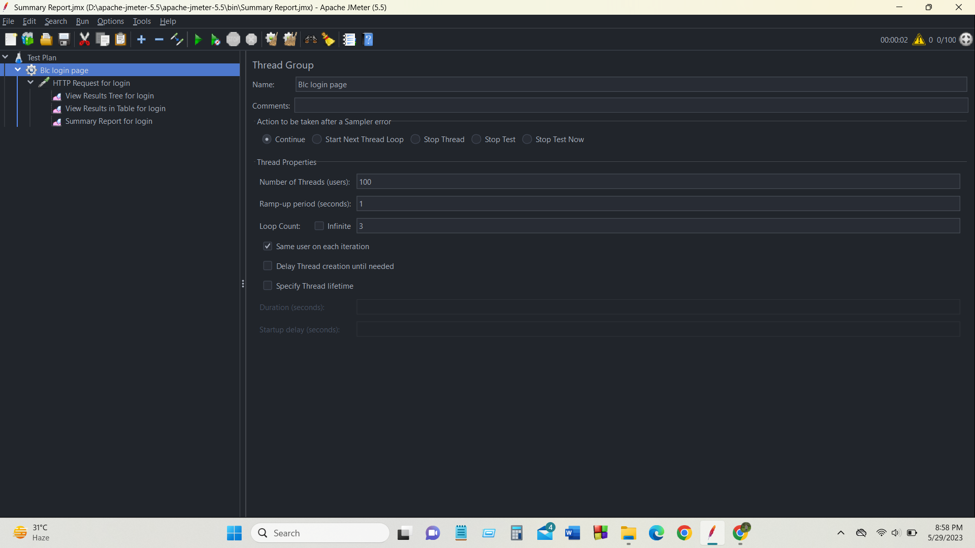
LOAD TESTING

Slide 13
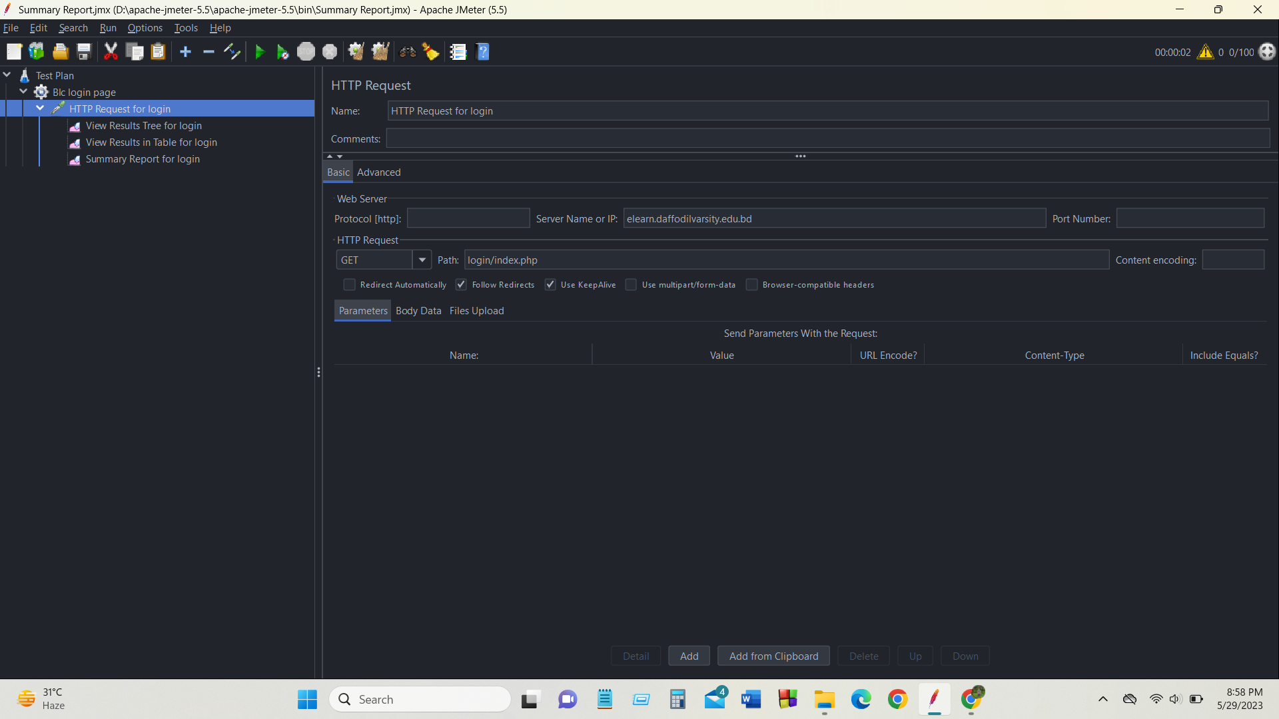
LOAD TESTING

Slide 14
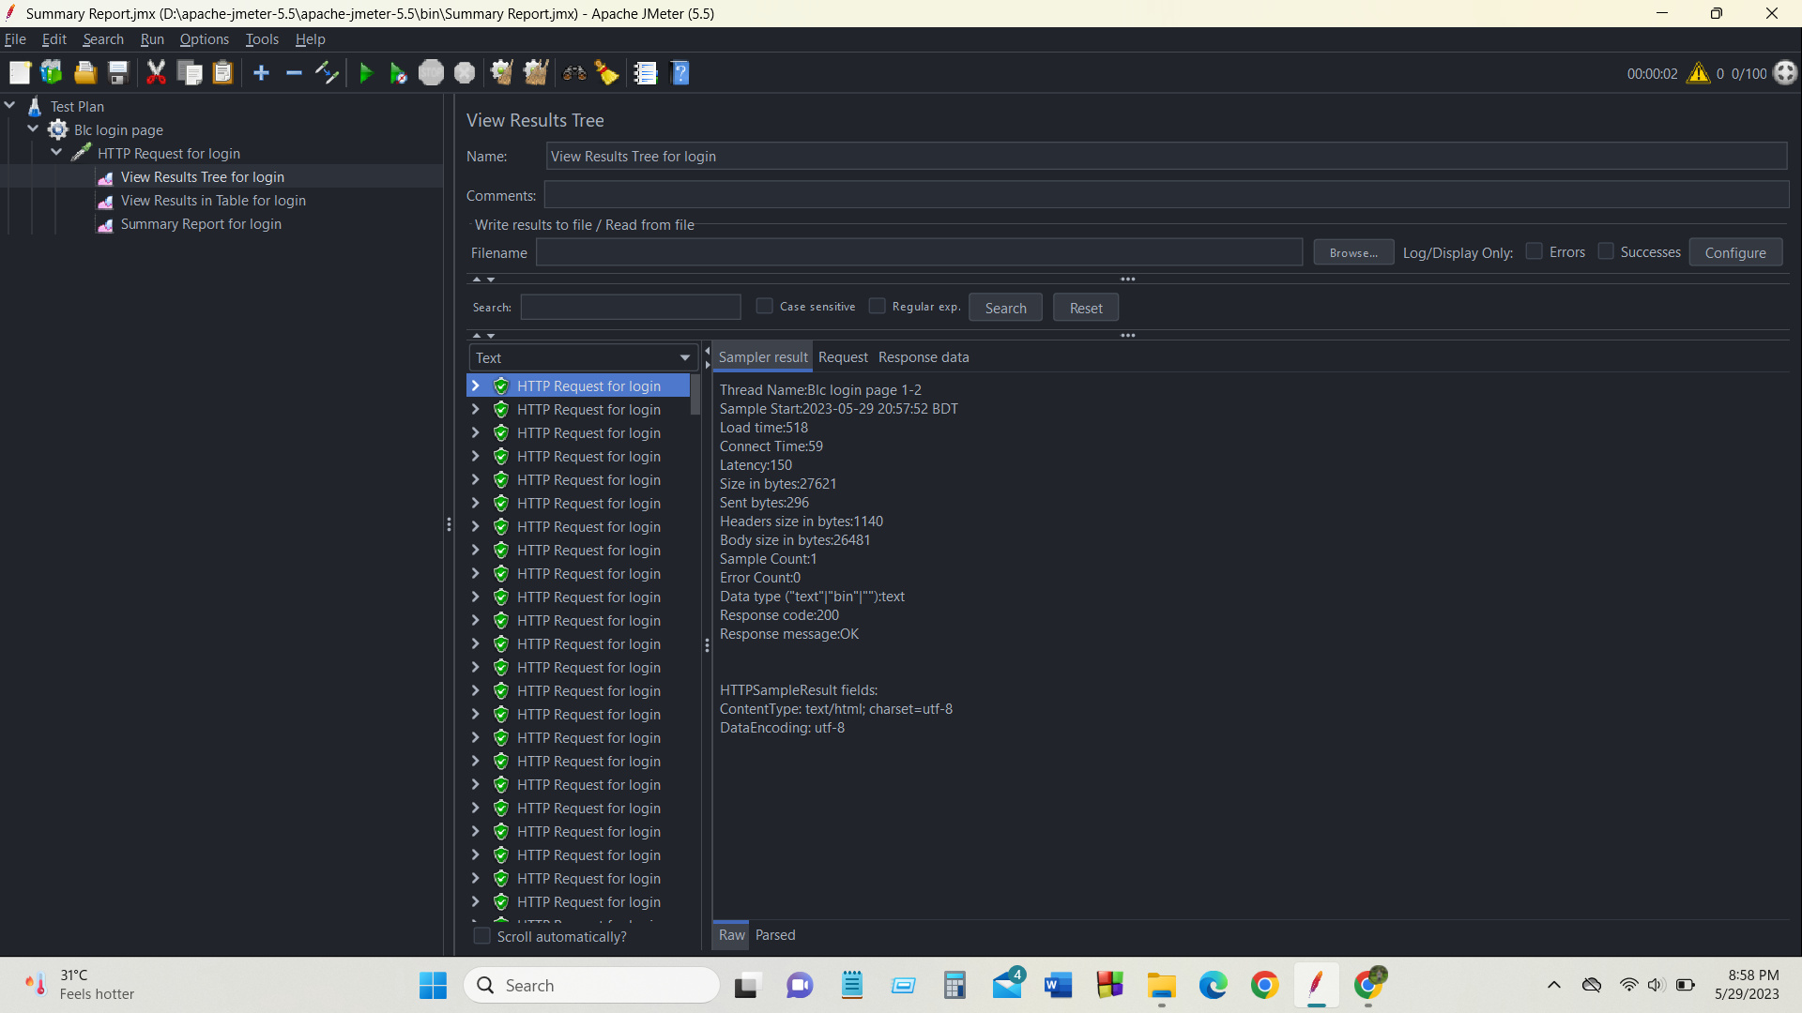
LOAD TESTING

Slide 15
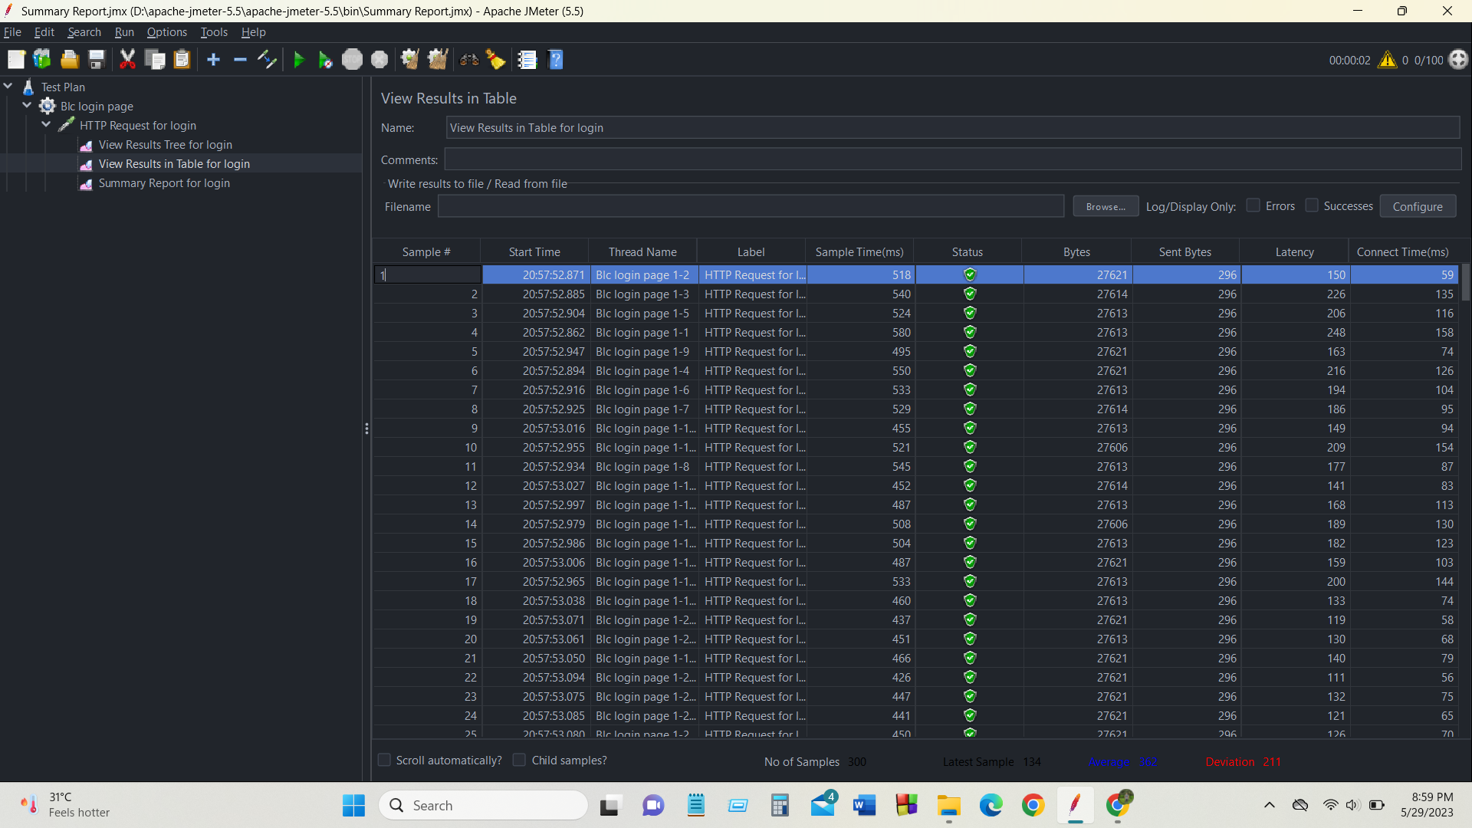
LOAD TESTING

Slide 16
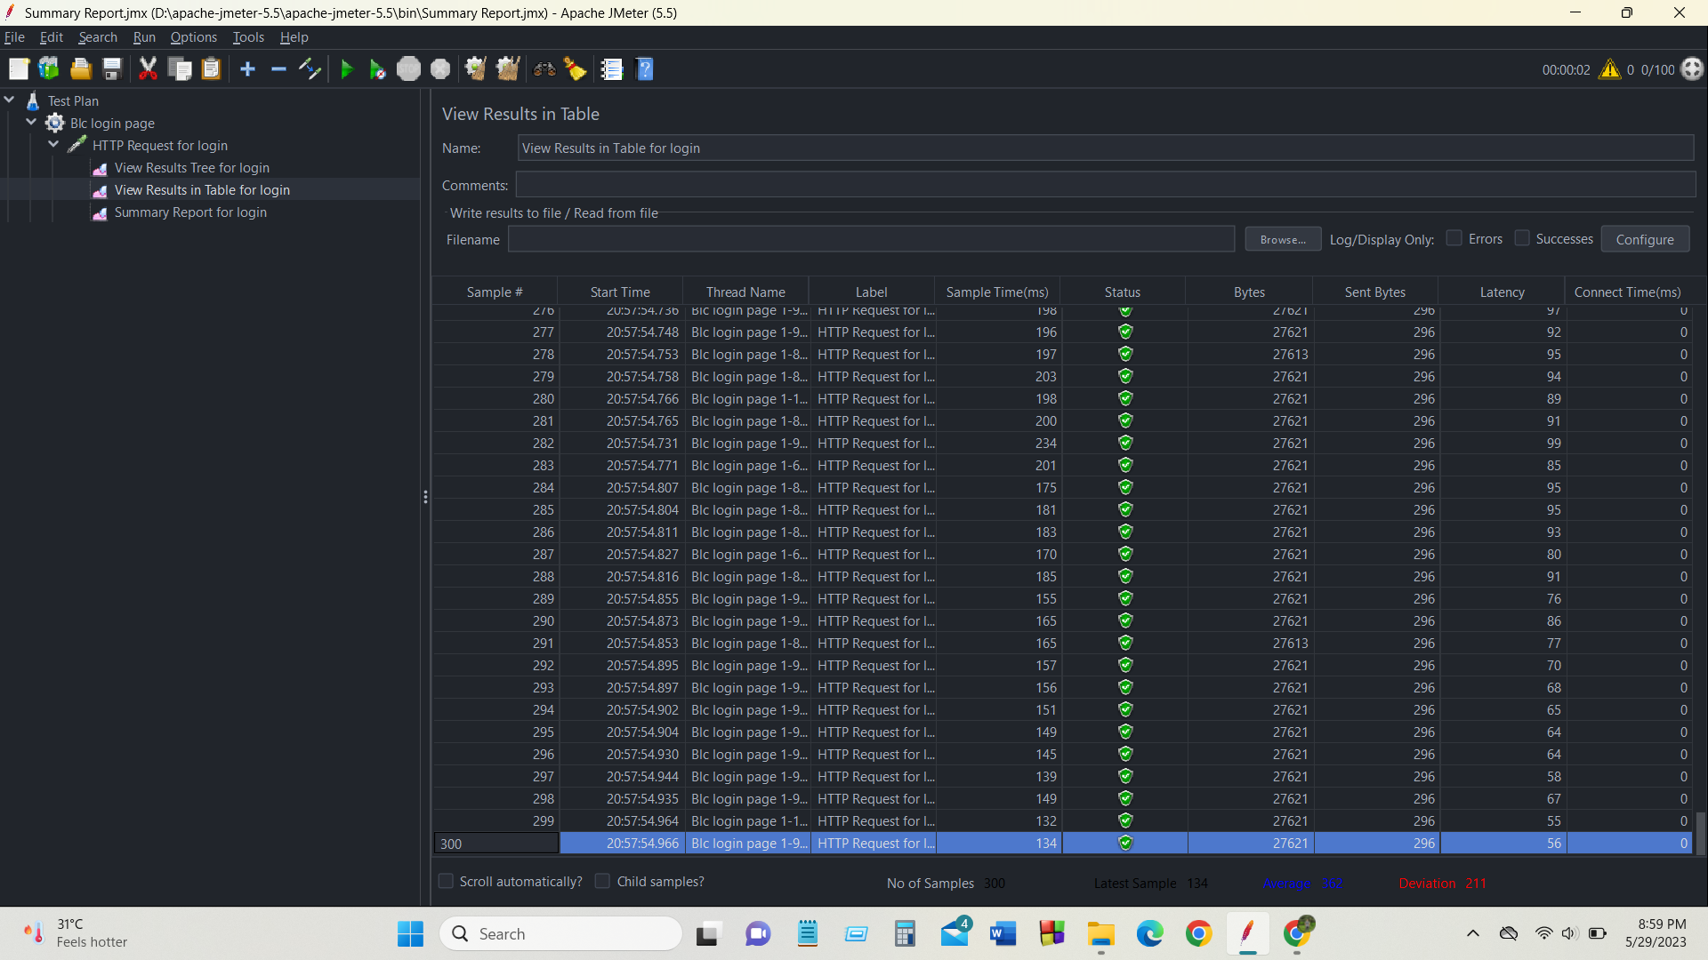
LOAD TESTING

Slide 17
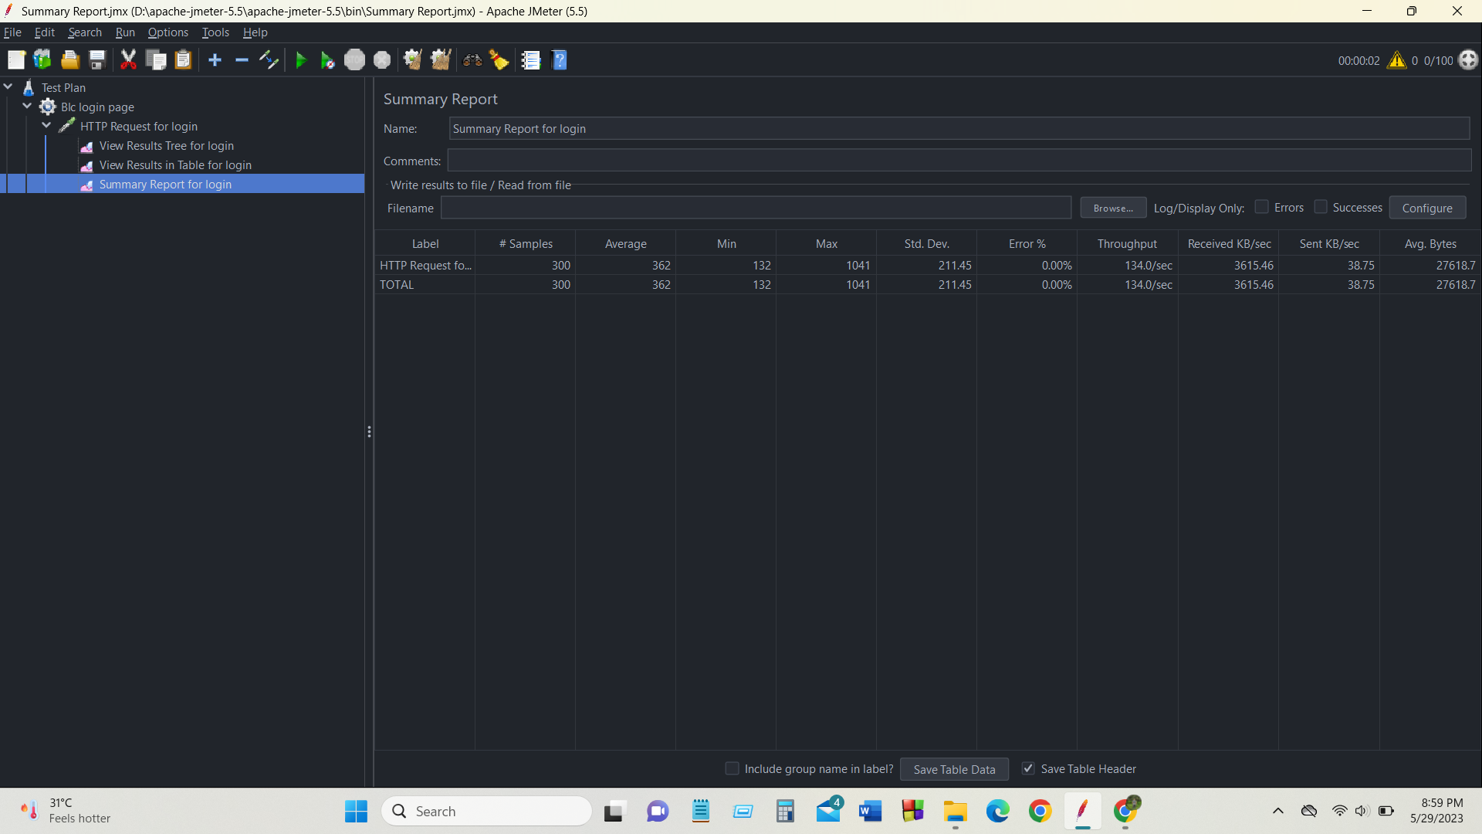
LOAD TESTING

Slide 18
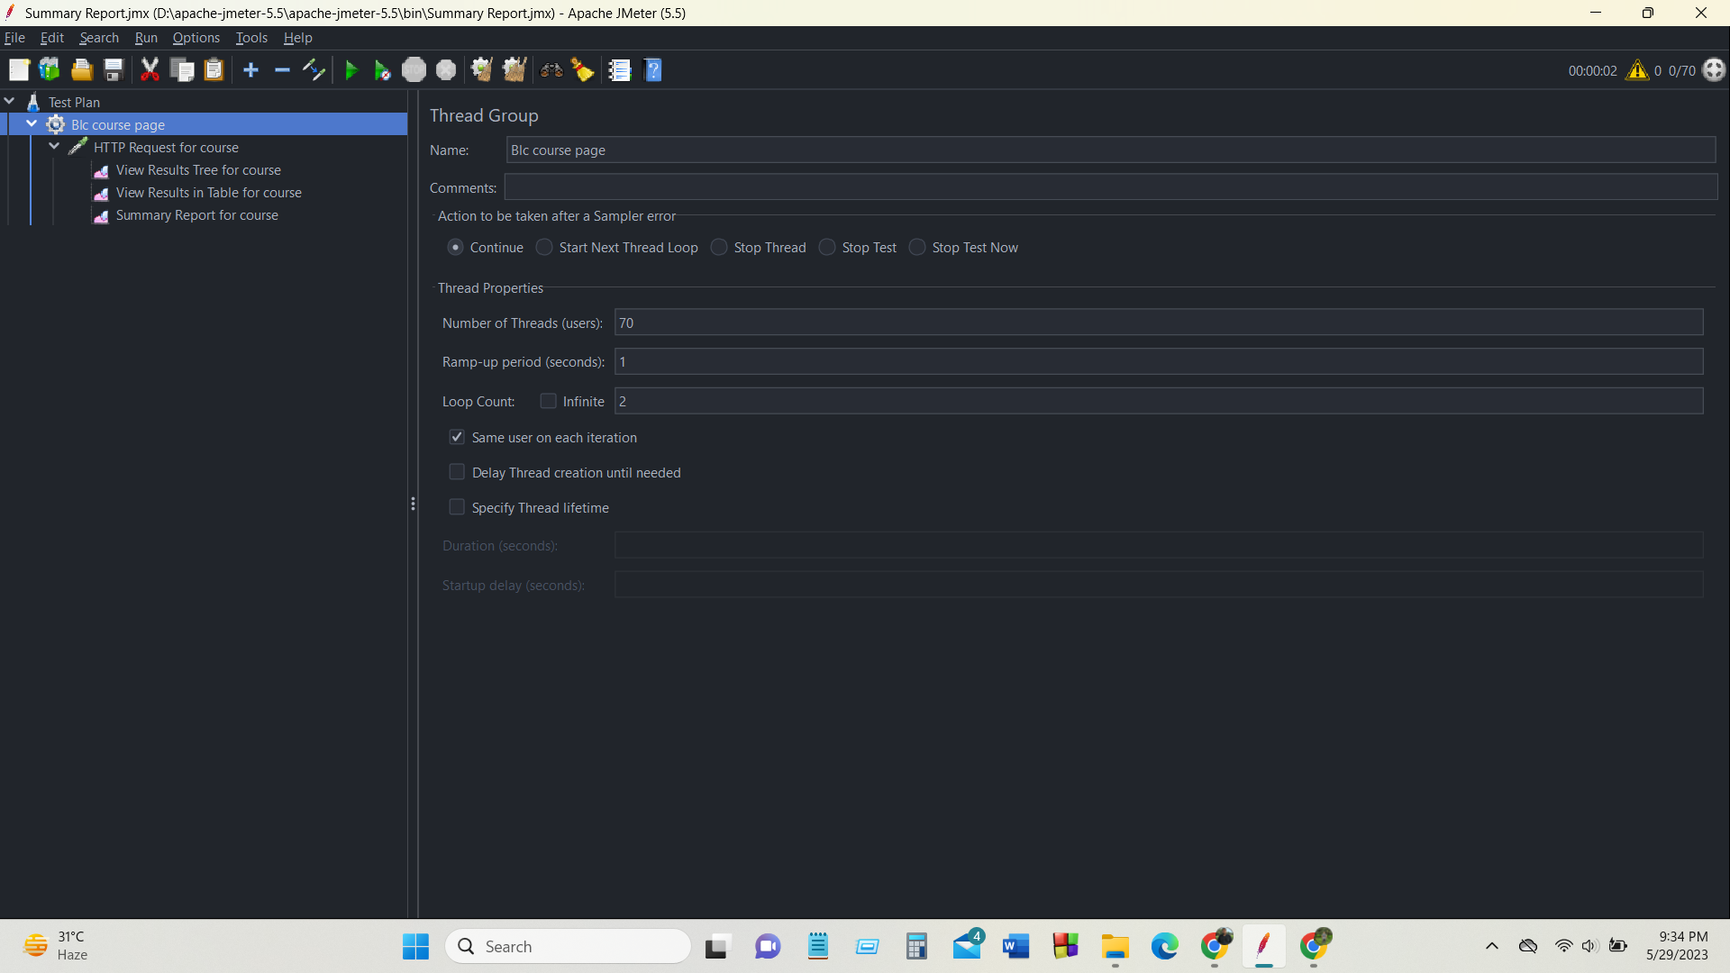
LOAD TESTING

Slide 19
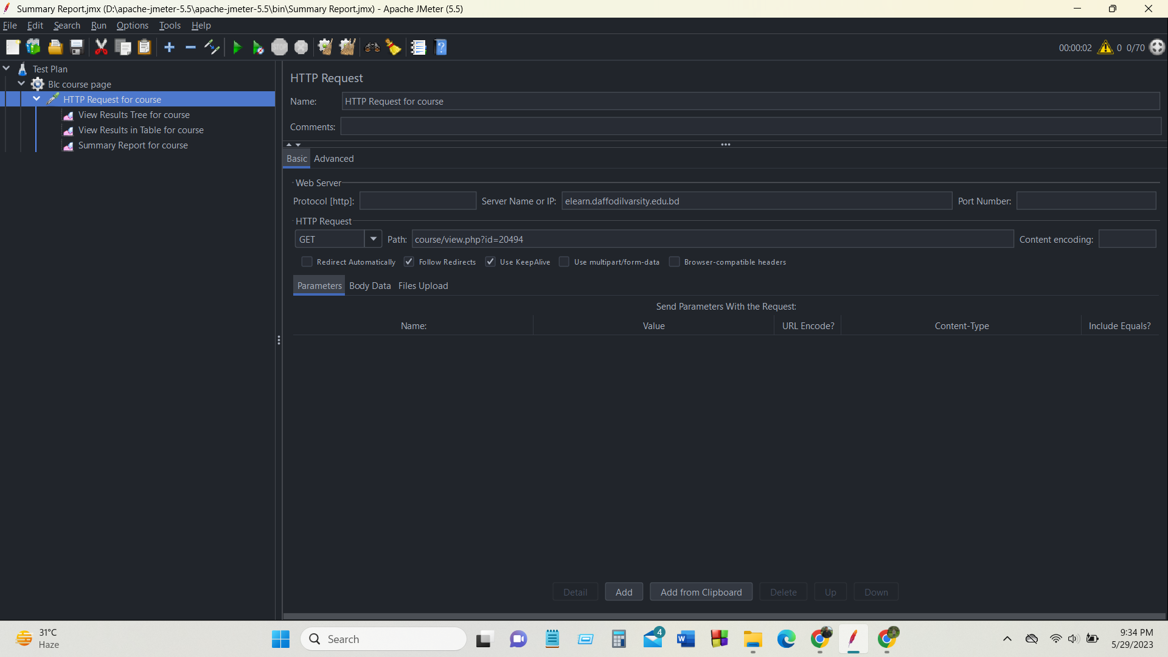
LOAD TESTING

Slide 20
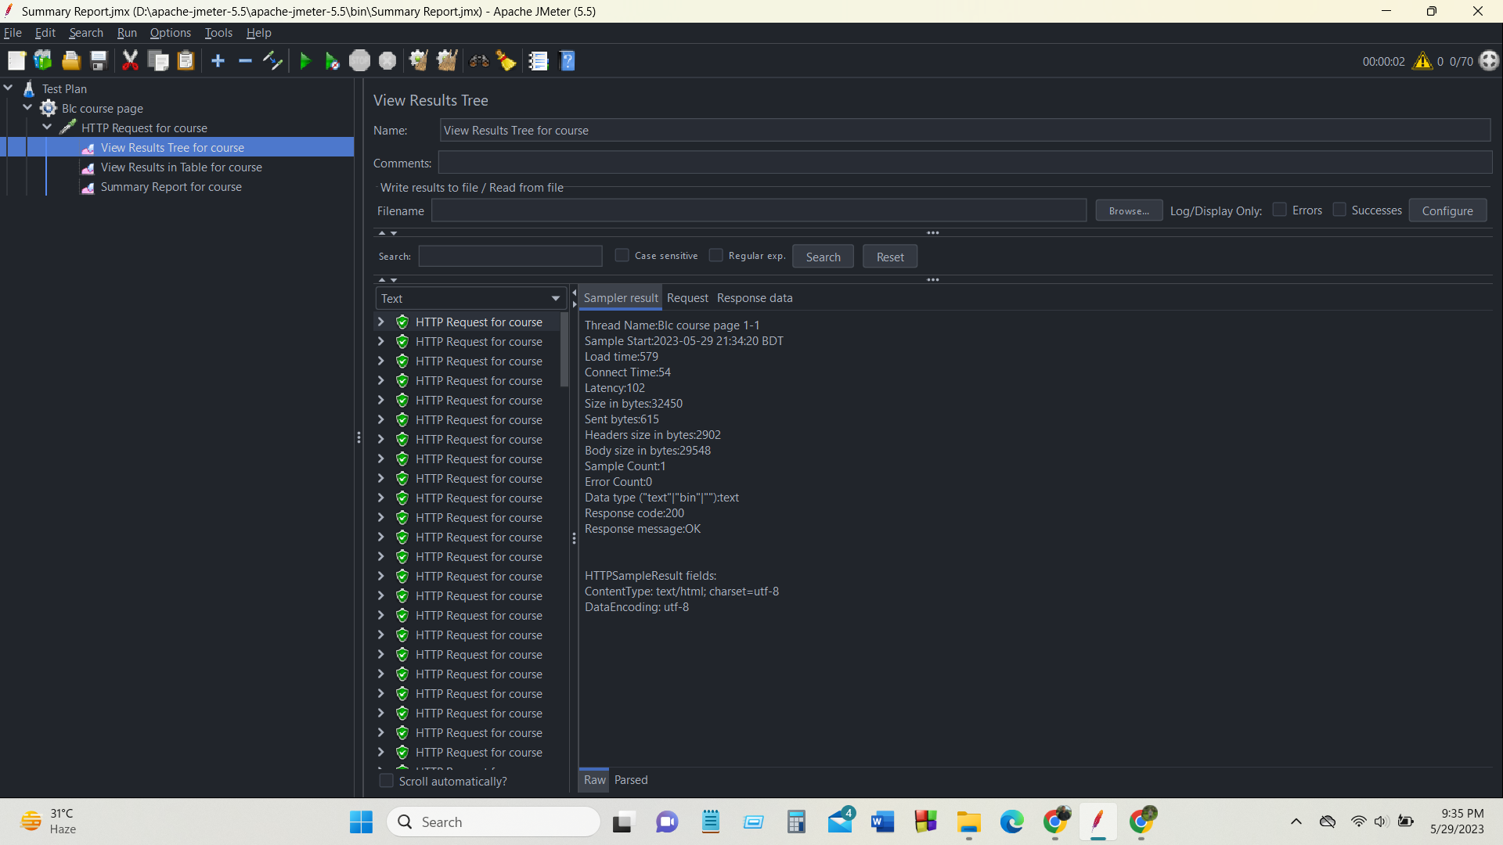
LOAD TESTING

Slide 21
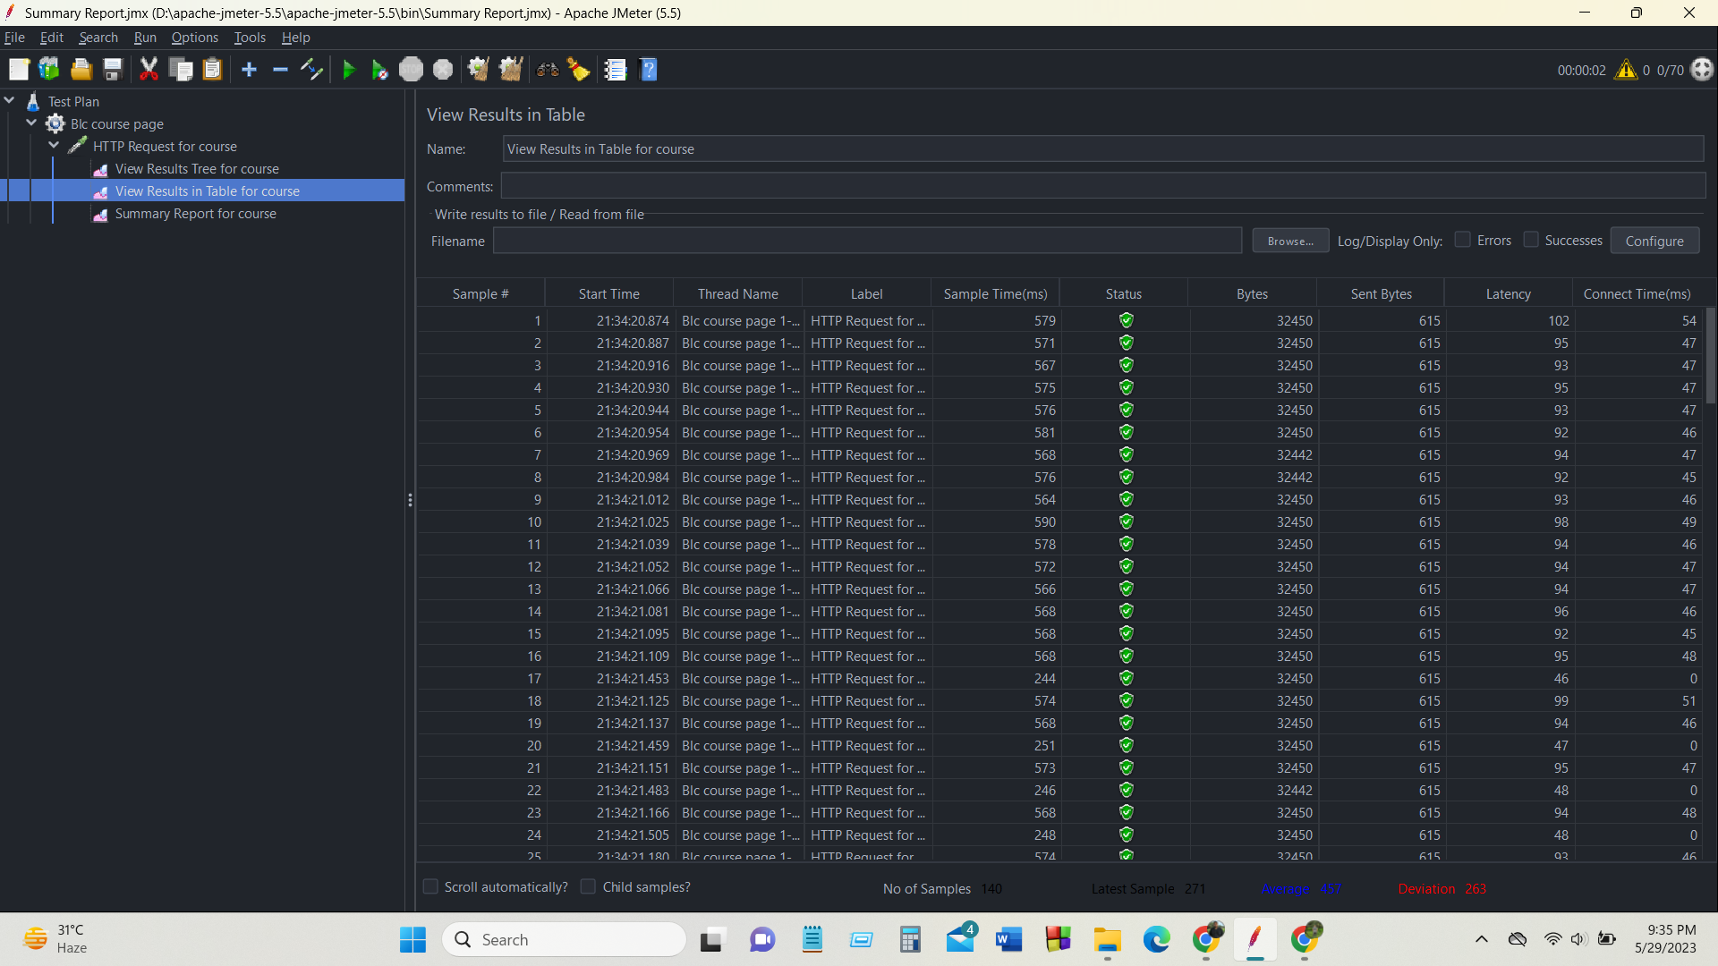
LOAD TESTING

Slide 22
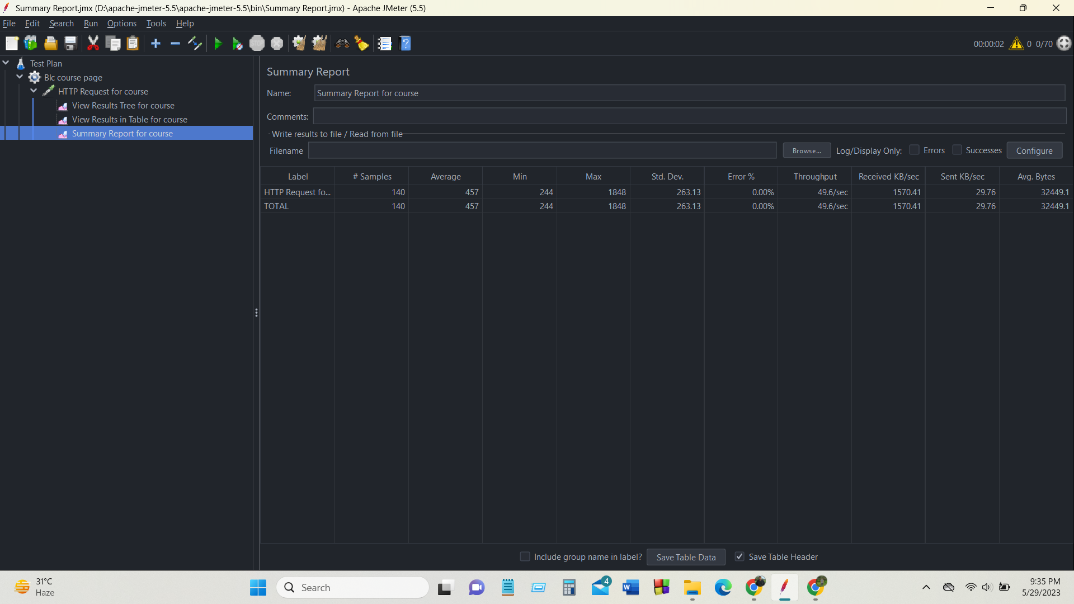
LOAD TESTING

Slide 23
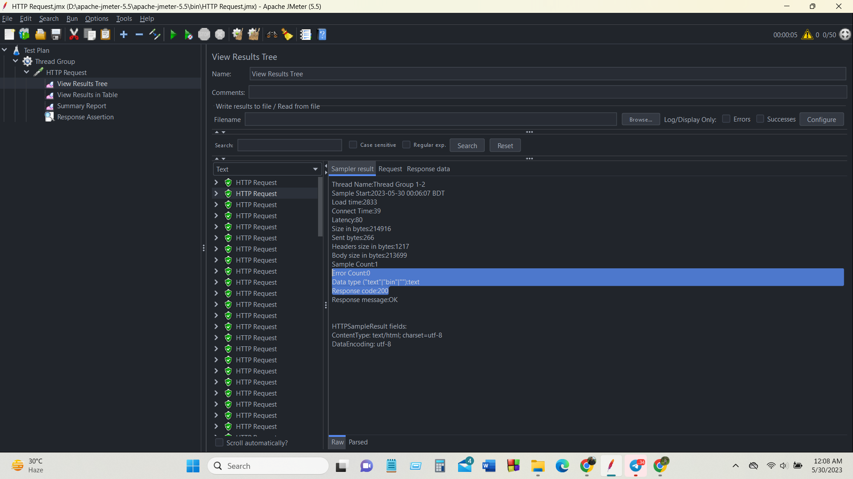
STRESS TESTING

Slide 24
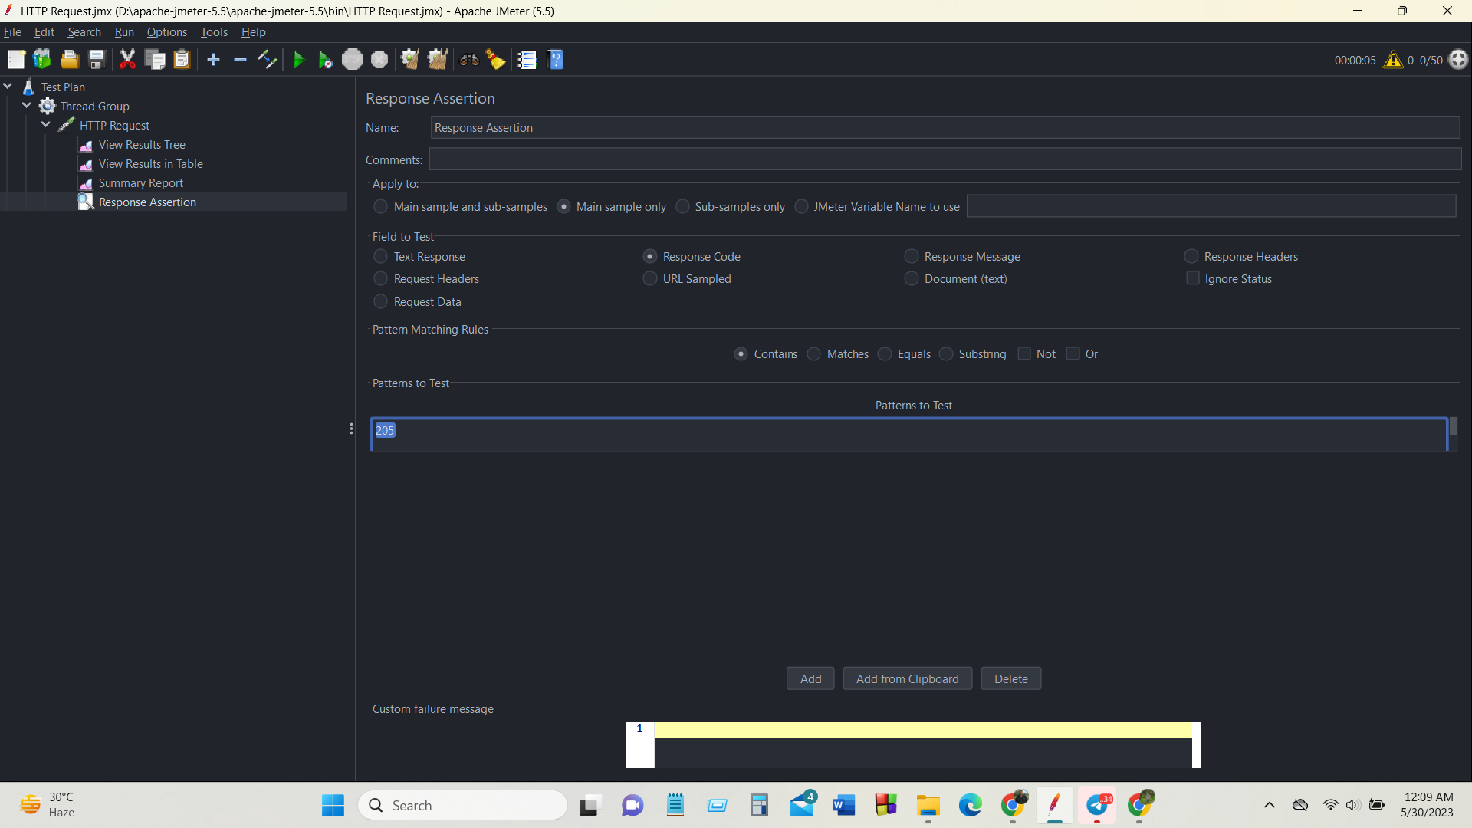
STRESS TESTING

Slide 25
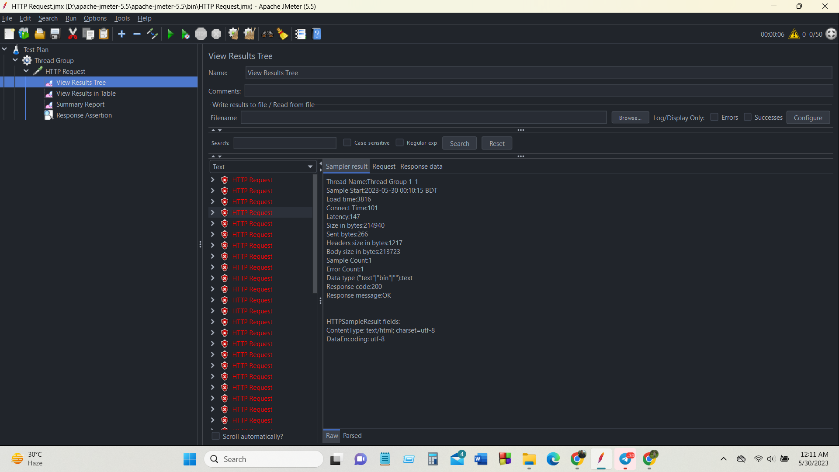
STRESS TESTING

Slide 26
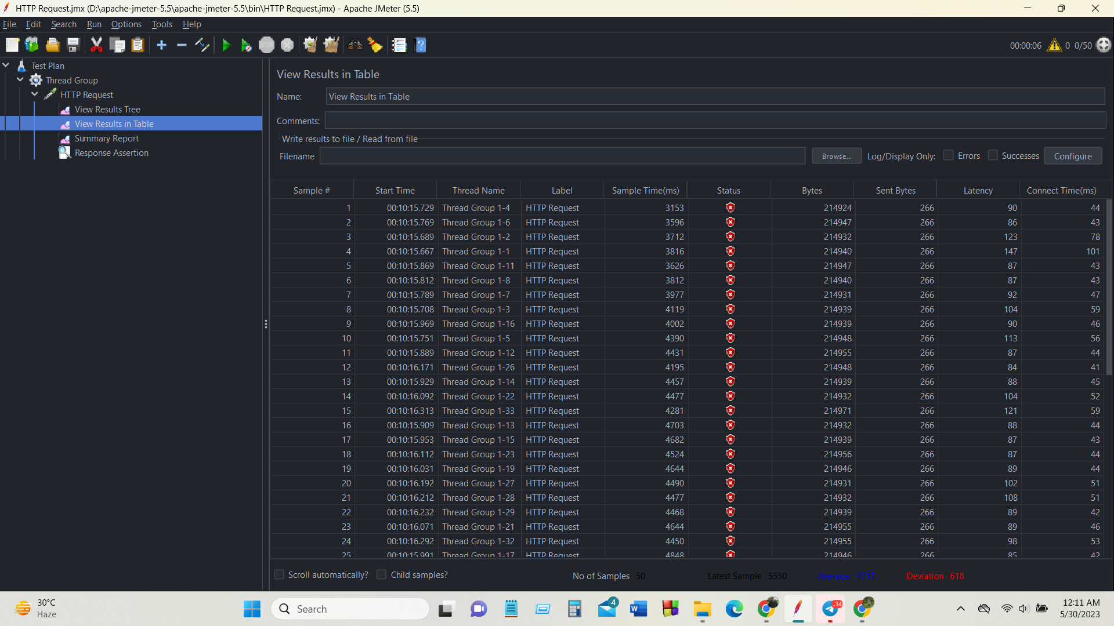
STRESS TESTING

Slide 27
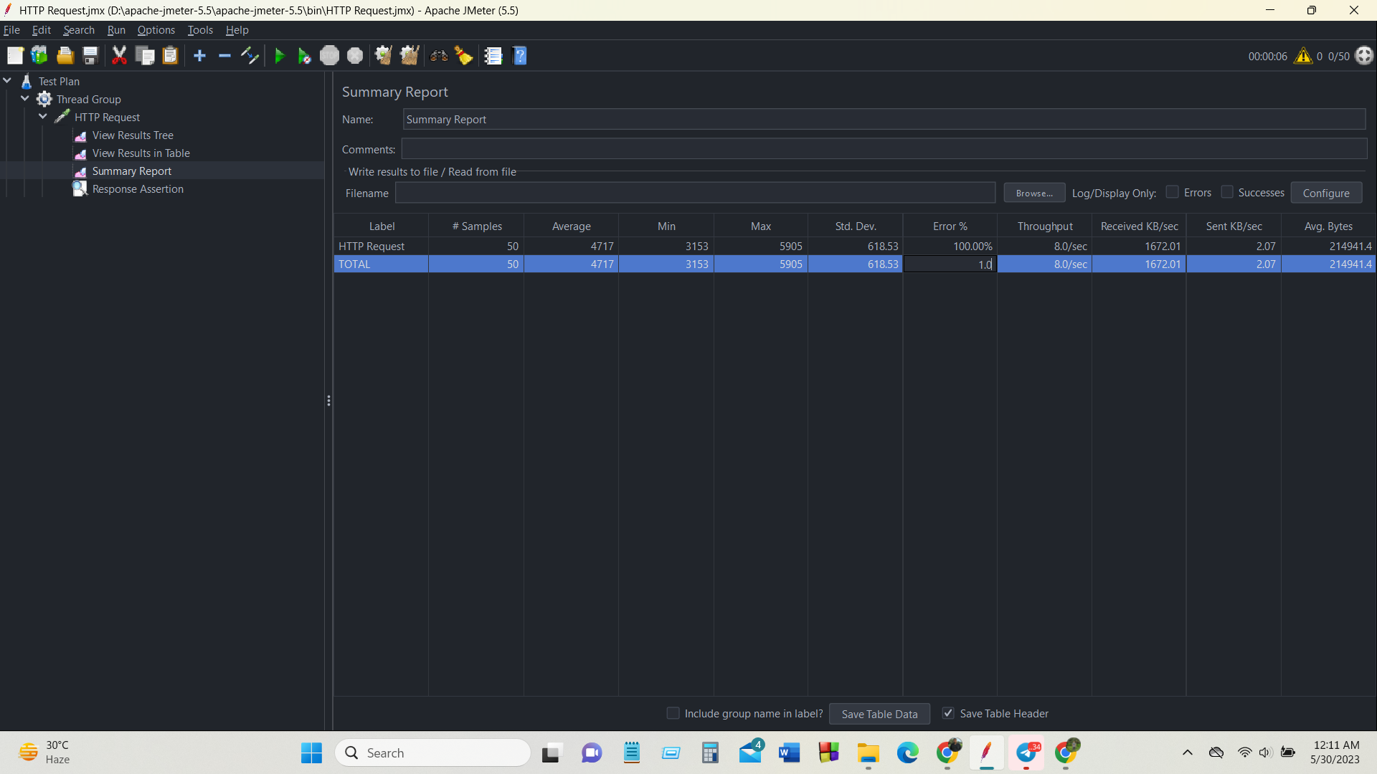
STRESS TESTING

Slide 28
CONCLUSION
Software testing is essential for software development to identify and rectify defects, reduce costs and save time, and ensure reliability, performance, and security. Through continuous improvement and feedback, developers can refine and optimize their applications, delivering high-quality software.

Slide 29
THANK YOU

